Slide 1
Module 7: Etherchannel
CCNP SWITCH: Implementing IP Switching
Notes:
Cisco Networking Academy Program
CCNP SWITCH: Implementing IP Switching
Chapter 2: Implementing VLANs in Campus Networks

Slide 2
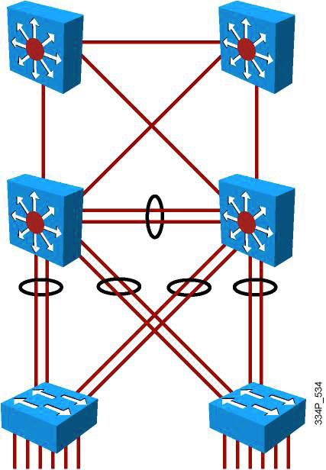
EtherChannel Technology
Up to 8 physical links can be bundled into a single logical EtherChannel link.
Usually EtherChannel is used for trunk links.
Configuration applied to port channel interface affects all physical interfaces assigned to the port channel.
Load balancing takes place between the physical links in an EtherChannel.
EtherChannels can be L2 or L3 interfaces.

Slide 3
Configuring EtherChannel
Step 1. Specify the interfaces that will compose the EtherChannel group. Using the range commands enables you to select several interfaces and configure them all together. A good practice is to start by shutting down these interfaces, so that incomplete configuration will not start to create activity on the link:
Switch(config)# interface range interface_type [interface_range]
Step 2. Specify the channeling protocol to be used. This command is not applicable to all Catalyst platforms. You can also specify the channeling protocol at Step 3:
Switch(config-if-range)# channel-protocol {pagp | lacp}
Step 3. Create the port-channel interface, if necessary, and assign the specified interfaces to it:
Switch(config-if-range)# channel-group number mode {active | on | {auto [non-silent]} | {desirable [non-silent]} | passive
Step 4. Specify the port-channel interface. When in the interface configuration mode, you can configure additional parameters. The physical interfaces will inherit these parameters. When this configuration is complete, you can reenable the physical ports in the EtherChannel bundle:
Switch(config)# interface port-channel number
Switch(config-if)# interface parameters
Notes:
The first step is to identify the ports for the EtherChannel on both switches. This helps identify any issues with previous configurations on the ports and ensures that the proper connections are available.
The network designer should already have decided whether this is going to be a Layer 3 or a Layer 2 connection. If it is a Layer 2 connection, each interface should have the appropriate protocol identified (PAgP or LACP), have a channel group number to associate all the given interfaces to a port group, and know whether negotiations should occur.
If this is a Layer 3 connection, a new virtual interface is created. This port-channel interface is then given an IP address. Each of the physical interfaces is then made into an EtherChannel by specifying the same channel group number as the port-channel interface number.
When the connections are established, a couple of commands can ensure that both sides of the EtherChannel have formed and are providing aggregated bandwidth.
EtherChannel support: All Ethernet interfaces on all modules support EtherChannel (maximum of eight interfaces) with no requirement that interfaces be physically contiguous or on the same module.
Speed and duplex: Configure all interfaces in an EtherChannel to operate at the same speed and in the same duplex mode. Also, if one interface in the bundle is shut down, it is treated as a link failure, and traffic traverses other links in the bundle.
Switched port analyzer (SPAN) and EtherChannel: An EtherChannel does not form if one of the interfaces is a SPAN destination port.
Layer 3 EtherChannels: Assign Layer 3 addresses to the port-channel logical interface, not to the physical interfaces in the channel.
VLAN match: All interfaces in the EtherChannel bundle must be assigned to the same VLAN or be configured as a trunk. In addition, Native VLANs should be matched across all the links on both switches.
Range of VLANs: An EtherChannel supports the same allowed range of VLANs on all the interfaces in a trunking Layer 2 EtherChannel. If the allowed range of VLANs is not the same, the interfaces do not form an EtherChannel, even when set to auto or desirable mode. For Layer 2 EtherChannels, either assign all interfaces in the EtherChannel to the same VLAN or configure them as trunks.
STP path cost: Interfaces with different STP port path costs can form an EtherChannel as long as they are otherwise compatibly configured. Setting different STP port path costs does not, by itself, make interfaces incompatible for the formation of an EtherChannel.
Port channel versus interface configuration: After you configure an EtherChannel, any configuration that you apply to the port-channel interface affects the EtherChannel. Any configuration that you apply to the physical interfaces affects only the specific interface you configured.

Slide 4
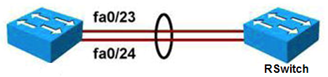
Example: EtherChannel Configuration
Switch(config)# interface fastethernet 0/23
Switch(config-if)# channel-group 2 mode active
Switch(config)# interface fastethernet 0/24
Switch(config-if)# channel-group 2 mode active
Switch(config)# interface port-channel 2
Switch(config-if)# switchport mode trunk
Switch(config-if)# switchport trunk native VLAN 99
Switch(config-if)# switchport trunk allowed VLAN 2,3,99
Remote Switch configuration
RSwitch(config)# interface fastethernet 0/23
RSwitch(config-if)# channel-group 5 mode on
RSwitch(config)# interface fastethernet 0/24
RSwitch(config-if)# channel-group 5 mode on
RSwitch(config)# interface port-channel 5
RSwitch(config-if)# switchport mode trunk
RSwitch(config-if)# switchport trunk native VLAN 99
Notes:
This example shows a Layer 2 EtherChannel bundle between two switches using LACP. Each switch shows two ports that are left to their default configuration. The switch on the left created EtherChannel 2, and the switch on the right created EtherChannel 5. These numbers are locally significant and do not need to match the neighbor configuration. The actual configuration of the link is then conducted on the EtherChannel interface. The link is configured to be unconditionally in 802.1q trunk mode, and some VLANs are pruned.
Speed and duplex: Configure all interfaces in an EtherChannel to operate at the same speed and in the same duplex mode.
VLAN match: All interfaces in the EtherChannel bundle must be assigned to the same VLAN or be configured as a trunk. Also make sure that all the interfaces are part of the same native VLANs on both switches.
Range of VLANs: An EtherChannel supports the same allowed range of VLANs on all the interfaces in a trunking Layer 2 EtherChannel.
Keep in mind that the EtherChannel interface configuration must be compatible with the underlying physical ports configuration. In the example, initially there is no specific configuration on each individual port for trunking, which implies that the default dynamic auto mode is applied. In this mode, ports detect whether the other side is a trunk and dynamically changes to trunk mode if needed. This mode is compatible with the trunk mode configured on the EtherChannel interface. The physical ports inherit the EtherChannel configuration and change to trunk mode.

Slide 5
Verifying EtherChannel (1)
You can use several commands to verify an EtherChannel configuration. On any physical interface member of an EtherChannel bundle, the show interfaces interface_id etherchannel command provides information on the role of the interface in the EtherChannel.
Interface FastEthernet 0/24 below is part of EtherChannel bundle 1.
The protocol for this EtherChannel is LACP.
Switch# show interfaces fa0/24 etherchannel
Port state = Up Sngl-port-Bndl Mstr Not-in-Bndl
Channel group = 1 Mode = Active Gcchange = -
Port-channel = null GC = - Pseudo port-channel = Po1
Port index = 0 Load = 0x00 Protocol = LACP

Slide 6
Verifying EtherChannel (2)
The show etherchannel number port-channel command can be used to display information about a specific port-channel.
Below Port-channel 1 consists of two physical ports, Fa0/23 and Fa0/24.
It uses LACP in active mode.
It is properly connected to another switch with a compatible configuration.This is why the port-channel is said to be in use.
Switch# show etherchannel 1 port-channel
Port-channels in the group:
---------------------------
Port-channel: Po7 (Primary Aggregator)
Age of the Port-channel = 195d:03h:10m:44s
Logical slot/port = 0/1 Number of ports = 2
Port state = Port-channel Ag-Inuse
Protocol = LACP
Ports in the Port-channel:
Index Load Port EC state No of bits
------+------+--------+--------------+-----------
0 55 fa0/23 Active 4
1 45 fa0/24 Active 4

Slide 7
Verifying EtherChannel (3)
When several port-channel interfaces are configured on the same device, the show etherchannel summary command is useful for displaying one-line information per port-channel.
As shown below; the switch has three EtherChannels configured: Groups 2 and 7 use LACP and Group 9 uses PAgP. Each EtherChannel has the member interfaces listed. All three groups are Layer 2 EtherChannels and are all in use (SU next to the port-channel number).
Switch# show etherchannel summary
Flags: D - down P - bundled in port-channel
I - stand-alone s - suspended
H - Hot-standby (LACP only)
R - Layer3 S - Layer2
U - in use f - failed to allocate aggregator
M - not in use, minimum links not met
u - unsuitable for bundling
w - waiting to be aggregated
d - default port
Number of channel-groups in use: 2
Number of aggregators: 2
Group Port-channel Protocol Ports
------+-------------+-----------+--------------------------------------------
2 Po2(SU) LACP g0/49(P) g0/50(P) g0/51(P) g0/52(P)
7 Po7(SU) LACP g0/47(P) g0/48(P)
9 Po9(SU) PAgP g0/8(P) g0/9(P)

Slide 8
Verifying EtherChannel (4)
The show running-config interface interface_id command displays sections of your configuration relevant to EtherChannel. The interface argument can be physical or logical.
Switch# show running-config interface g0/48
Building configuration...
Current configuration : 154 bytes
interface GigabitEthernet0/48
switchport access vlan 41
switchport trunk encapsulation dot1q
switchport mode trunk
channel-group 7 mode active
Switch# show running-config interface port-channel 7
Building configuration...
Current configuration : 92 bytes
interface Port-channel7
switchport trunk encapsulation dot1q
switchport mode trunk

